Slide 1

Analysis of COVID-19 and County Demographics
By Brendan Chan

Slide 2

COVID -19
Began in Wuhan, China
Confirmed cases in the U.S. starting in late January
Spread via droplets from talking, coughing, sneezing
Prevention: social distancing, wearing masks
Symptoms vary widely with many asymptomatic

Slide 3
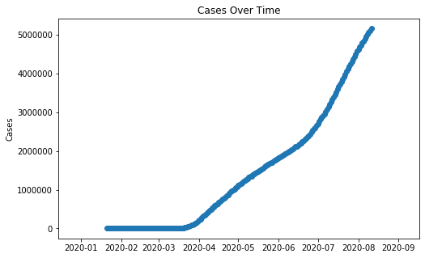
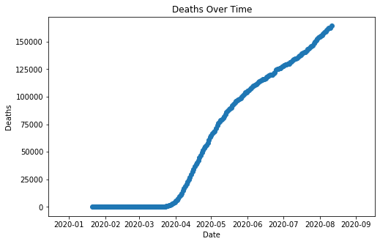
With Respect to Time
Notes:
Number of cases accelerated in July, possibly due to a relaxing of lockdown restrictions
Rate of deaths has decreased somewhat over time.
Developed better treatments?

Slide 4
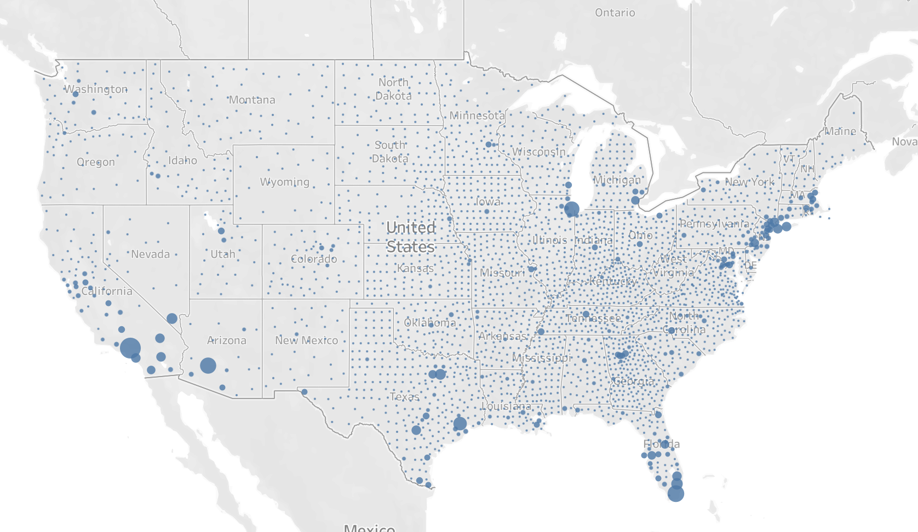
Notes:
Raw number of cases
Areas of high population density are at risk
Los Angeles, Pheonix has been hit hard

Slide 5
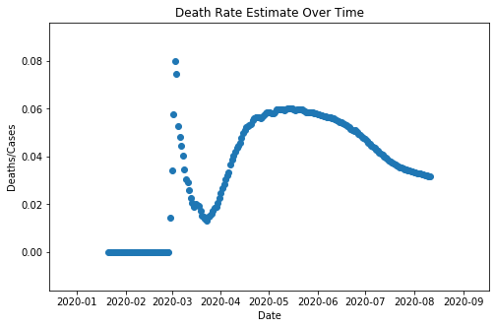
Mortality Rates
Around 2-3% on average.
Possibly < 2% from underreporting
Demographic Differences?
Notes:
Are there demographic differences?

Slide 6
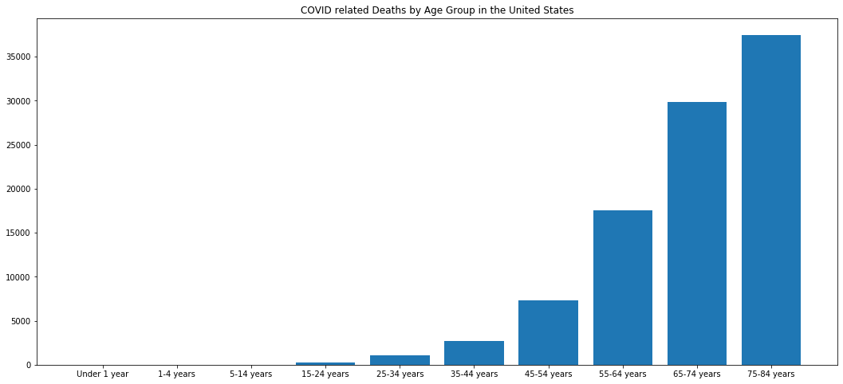
Older People are more vulnerable
Notes:
The older

Slide 7
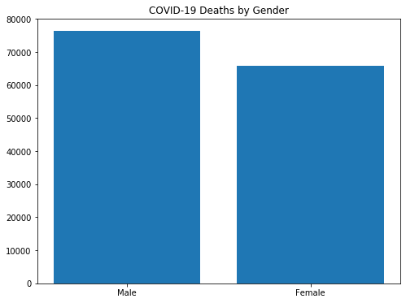
Men are at higher risk
54% of deaths are men
Men are 16% more likely to die than women
Women generally have a stronger immune system

Slide 8
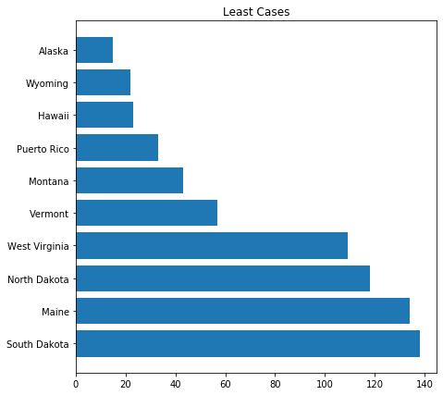
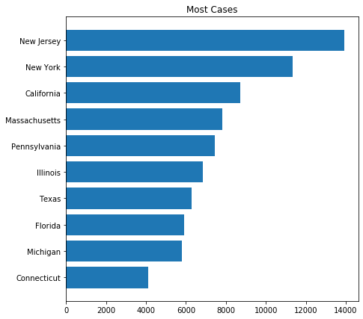
States
Notes:
States with the least cases have low population density, are islands
States with high number of cases have high population density (coastal)

Slide 9
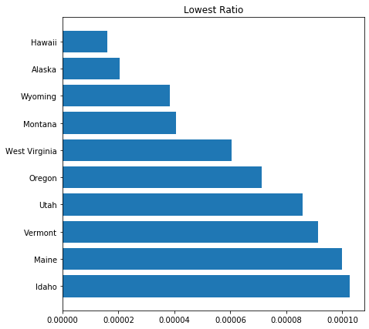
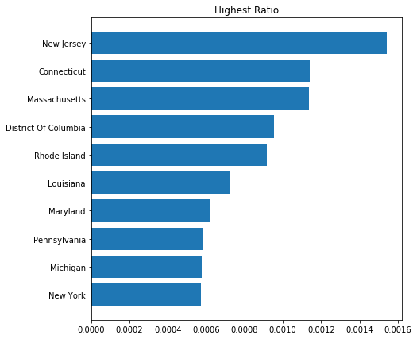
Ratio of Deaths to State Population
Notes:
California doesn’t make it onto the list for highest ratio
East coast suffers from high death:population ratio due to population density

Slide 10
Census Data at the County Level
2018 county demographics data from government census database
Demographic Groups: Age, sex, race
Goal: Make inferences on how covid affects different populations based on age, sex, and race

Slide 11
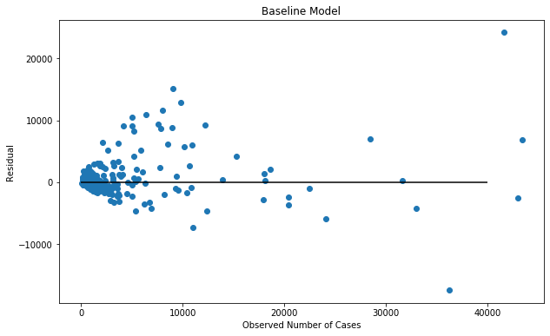
Baseline Model: Predicting Cases
OLS model
Use only population
3:1 split
Train R2: 0.87
Test R2: 0.73
RMSE: 3979
Notes:
Overfit, but not bad. Population explains 73 percent of variability in the data

Slide 12
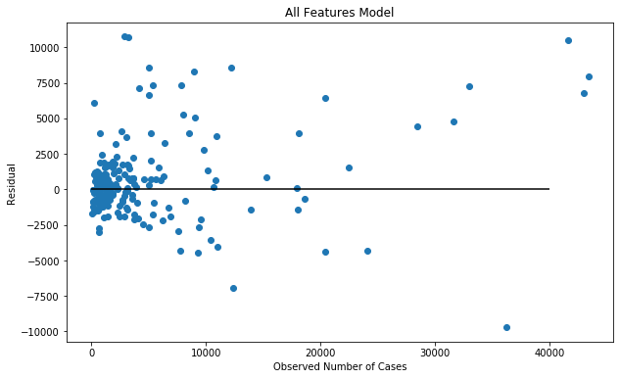
Throw Everything at the Wall Model
Train R2: 0.97
Test R2: 0.85
RMSE: 2940
Feature correlations
Inferences:
New Mexico, lower cases
Louisiana, higher cases
Notes:
Features are dependent on one another. For instance, age groups are correlated with race, median age
Makes coefficients uninterpretable.
Not many features were statistically significant

Slide 13
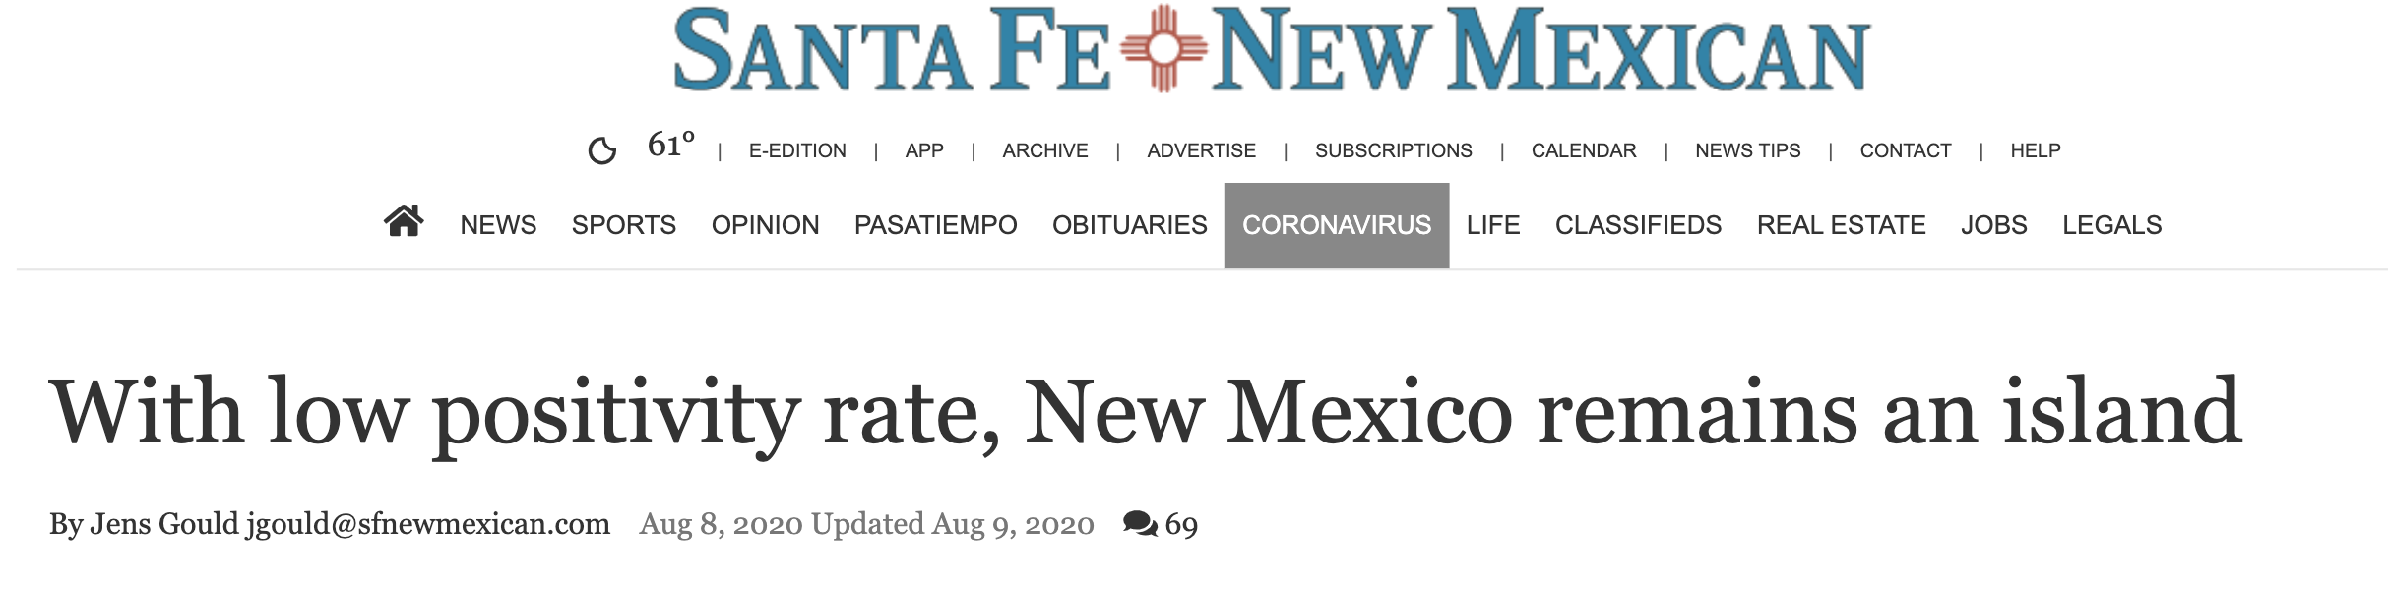
Deep Dive: New Mexico
New Mexico shut down its economy sooner than most states
Slower reopening of economy in June
Contact tracing efforts
Significantly Ramped up testing
Close to testing facilities, reducing turnaround time
Republicans critical, irreparable damage to economy

Slide 14
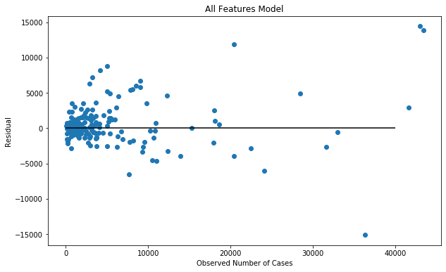
LASSO Model + OLS Model
Features chosen using LASSO
Train R2: 0.94
Test R2: 0.85
RMSE: 3020
Notes:
Not many features were statistically significant

Slide 15
Inferences
Statistically Significant Coefficients:
White Americans: 0.0138
African Americans: 0.0229
Hispanic or Latino American: 0.0284
American Indians & Alaska Natives: 0.1574
Asian Americans: -0.0226
Suggests that hispanic, black, and American indian populations have been hit hardest
Overrepresentation in essential workforce, lower income communities

Slide 16
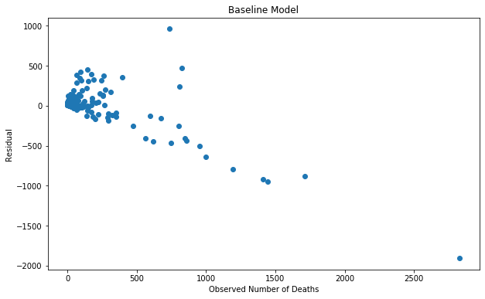
Baseline Model: Predicting Deaths
Train R2: 0.67
Test R2: 0.44
RMSE: 249
Not very good!

Slide 17
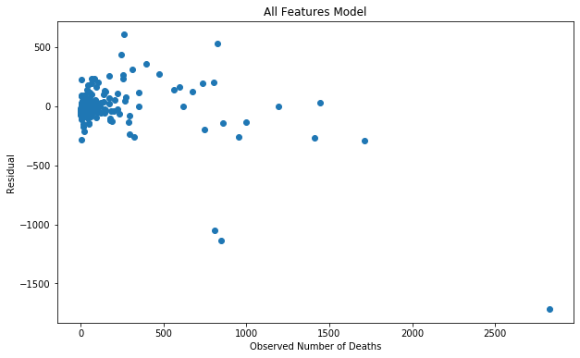
Throw Everything at the Wall Model
Train R2: 0.93
Test R2: 0.62
RMSE: 206
Notes:
Inference is difficult.

Slide 18

LASSO + OLS Model
Train R2: 0.90
Test R2: 0.66
RMSE: 196
High Number of features
Difficult to make inference
Notes:
Inference is difficult due to high number of features

Slide 19
Recommendations
Be cautious about reopening schools. Kids could be spreading COVID.
Allow for flexibility: households with both children and elderly should consider homeschool or online school.
Frequent testing and faster results
Contact Tracing
Hazard pay for essential workers
Balance between economy and public health. This is a marathon.
Notes:
We want to minimize covid deaths and damage to the economy at the same time.

Slide 20
Thanks For Listening!

